Slide 2
USENIX Security '21 - SLAP: Improving Physical Adversarial Examples with Short-Lived Adversarial
https://www.youtube.com/watch?v=o4LrVm5LP2E

Slide 4
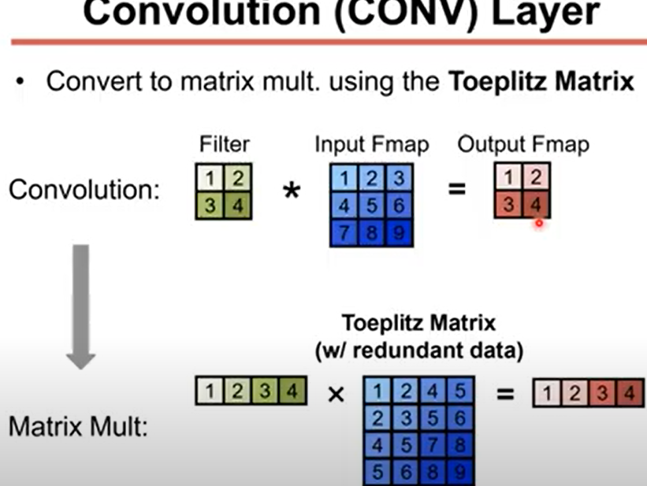
Toeplitz Matrix

